Slide 1

Image Processing Tool: Version 2.0
The A Team
Sanan Aamir, Romando Garcia,
Anne Lam, James Rowe, Hieu Tran
Final Presentation
May 4, 2015

Slide 2
Outline
Introduction
System Architecture
Version 1.0 and new objectives in Version 2.0
Plan
Organization
Work-to-date and Future Work

Slide 3
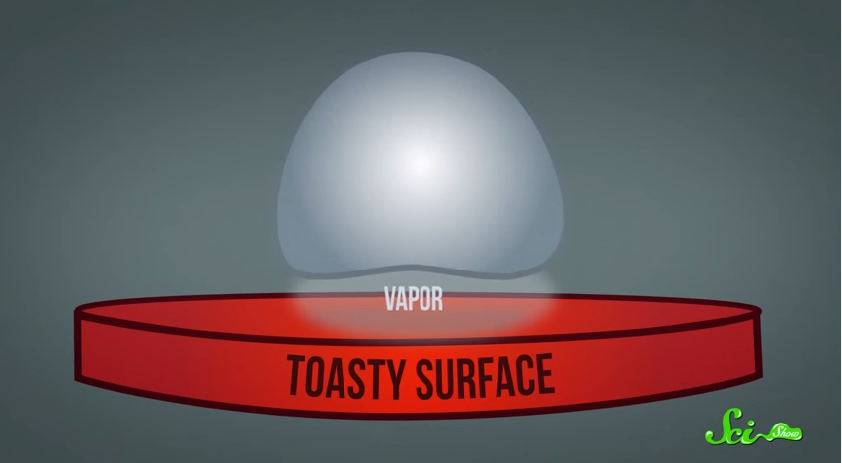
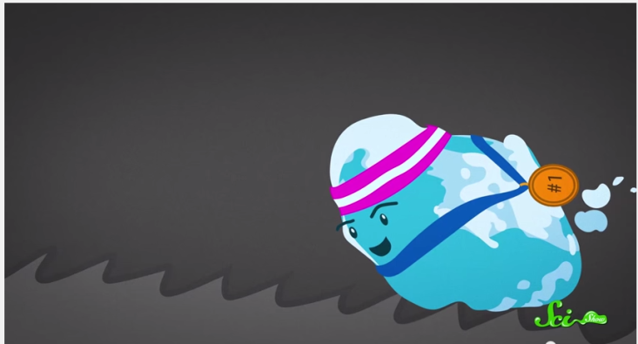
Introduction
The Leidenfrost Effect
Heating a liquid droplet above its boiling point creates a vapor pillow of its own gases underneath it
With little friction between vapor and surface, slight disturbances move the droplet
Ratchet surface gives just the right disturbance to control the movement
Notes:
Description of problem / user's work context -25%
Plan -10%
Process Model -5%
Team Organization -5%
Interface Design and System Design -25%
System to date/ What still is left -5%
Organization of presentation -10%
Creativity -15%

Slide 4
Our objective
Potential uses in micro-cooling
Customers, Dr. Ok and Dr. Guo, require data on droplet kinetics
Collect data from images taken through high-speed camera

Slide 5
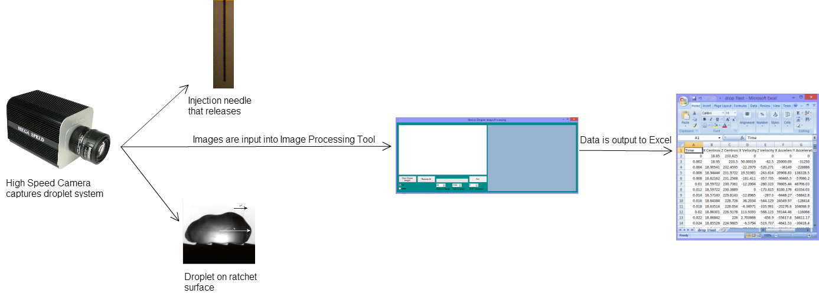
System Architecture

Slide 6
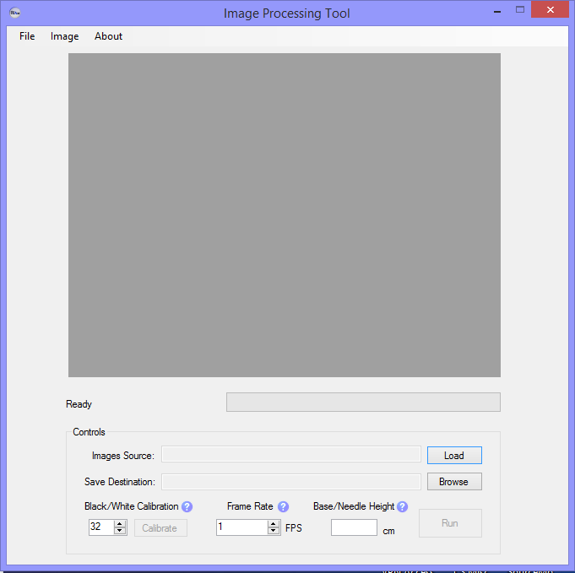
Demonstration
Load Images
Name Output File
Calibrate Processed Image
Run data set
Enter frames per second
Enter distance between base/needle if known
Notes:
Then actually demo – use data set that required sensitive calibration.

Slide 7
Test Report
Deviations from Requirements
Known problems
Efficiency may not be improved
Processing time up to 2.5x longer vs Version 1.0
From ~1 min to ~2 min
But more robust, accurate
Determined location of needle/ratchet for each image
No need for consideration of camera position – can safely assume is constant
Run – Stop – Run again sequence may interrupt thread processes – cause crash
Similar issue with Exiting Tool during IO
Base/Needle height may not be measured accurately, will affect results
Notes:
Test Report – known problems; deviations from reqs

Slide 8
Deployment Issues
Source of bugs difficult to pinpoint
UI changed fairly often
Implementation phase longer than expected

Slide 9
Project Deviations
Overall speed is slower
Microsoft Excel is required
Fine-tuning results consists of adjusting black/white calibration value

Slide 10
Hypothetical – Sanan
What if we had more time?
What if we could start over?
What we learned

Slide 11
Hypothetical – Anne
What if we had more time?
Improve processing time, design of interface (change color scheme of form), ensure customer satisfaction
What if we could start over?
Would start coding sooner
Plan/work on more defined, divided goals/milestones
Interact more with customer
What I learned
Image processing/manipulation through C#
Software Engineering Documentation
Team work/brainstorming

Slide 12
Hypothetical – Romando
What if we had more time?
What if we could start over?
What we learned

Slide 13
Hypothetical – James
What if we had more time?
Further optimization of process time
What if we could start over?
Collaborate with customer more often
Consider an Agile development approach
What I learned
Proper software development process
Practical use of multithreading

Slide 14
Conclusion
Project is overall success
Almost all goals achieved
Accurate results
Highly automated (Little user interaction)
Structured development process

Slide 15
References
"The Leidenfrost Effect: How to Make a Liquid Levitate." YouTube. YouTube, n.d. Web. 10 Mar. 2015.
Questions?

